Slide 1

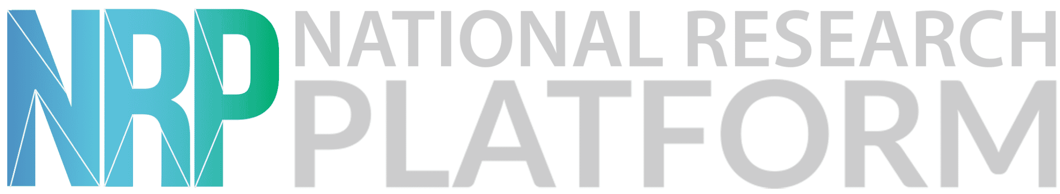
The National Research Platform
Fall Training Series
Mohammad Firas Sada
University of California, San Diego
San Diego Supercomputer Center

Slide 2
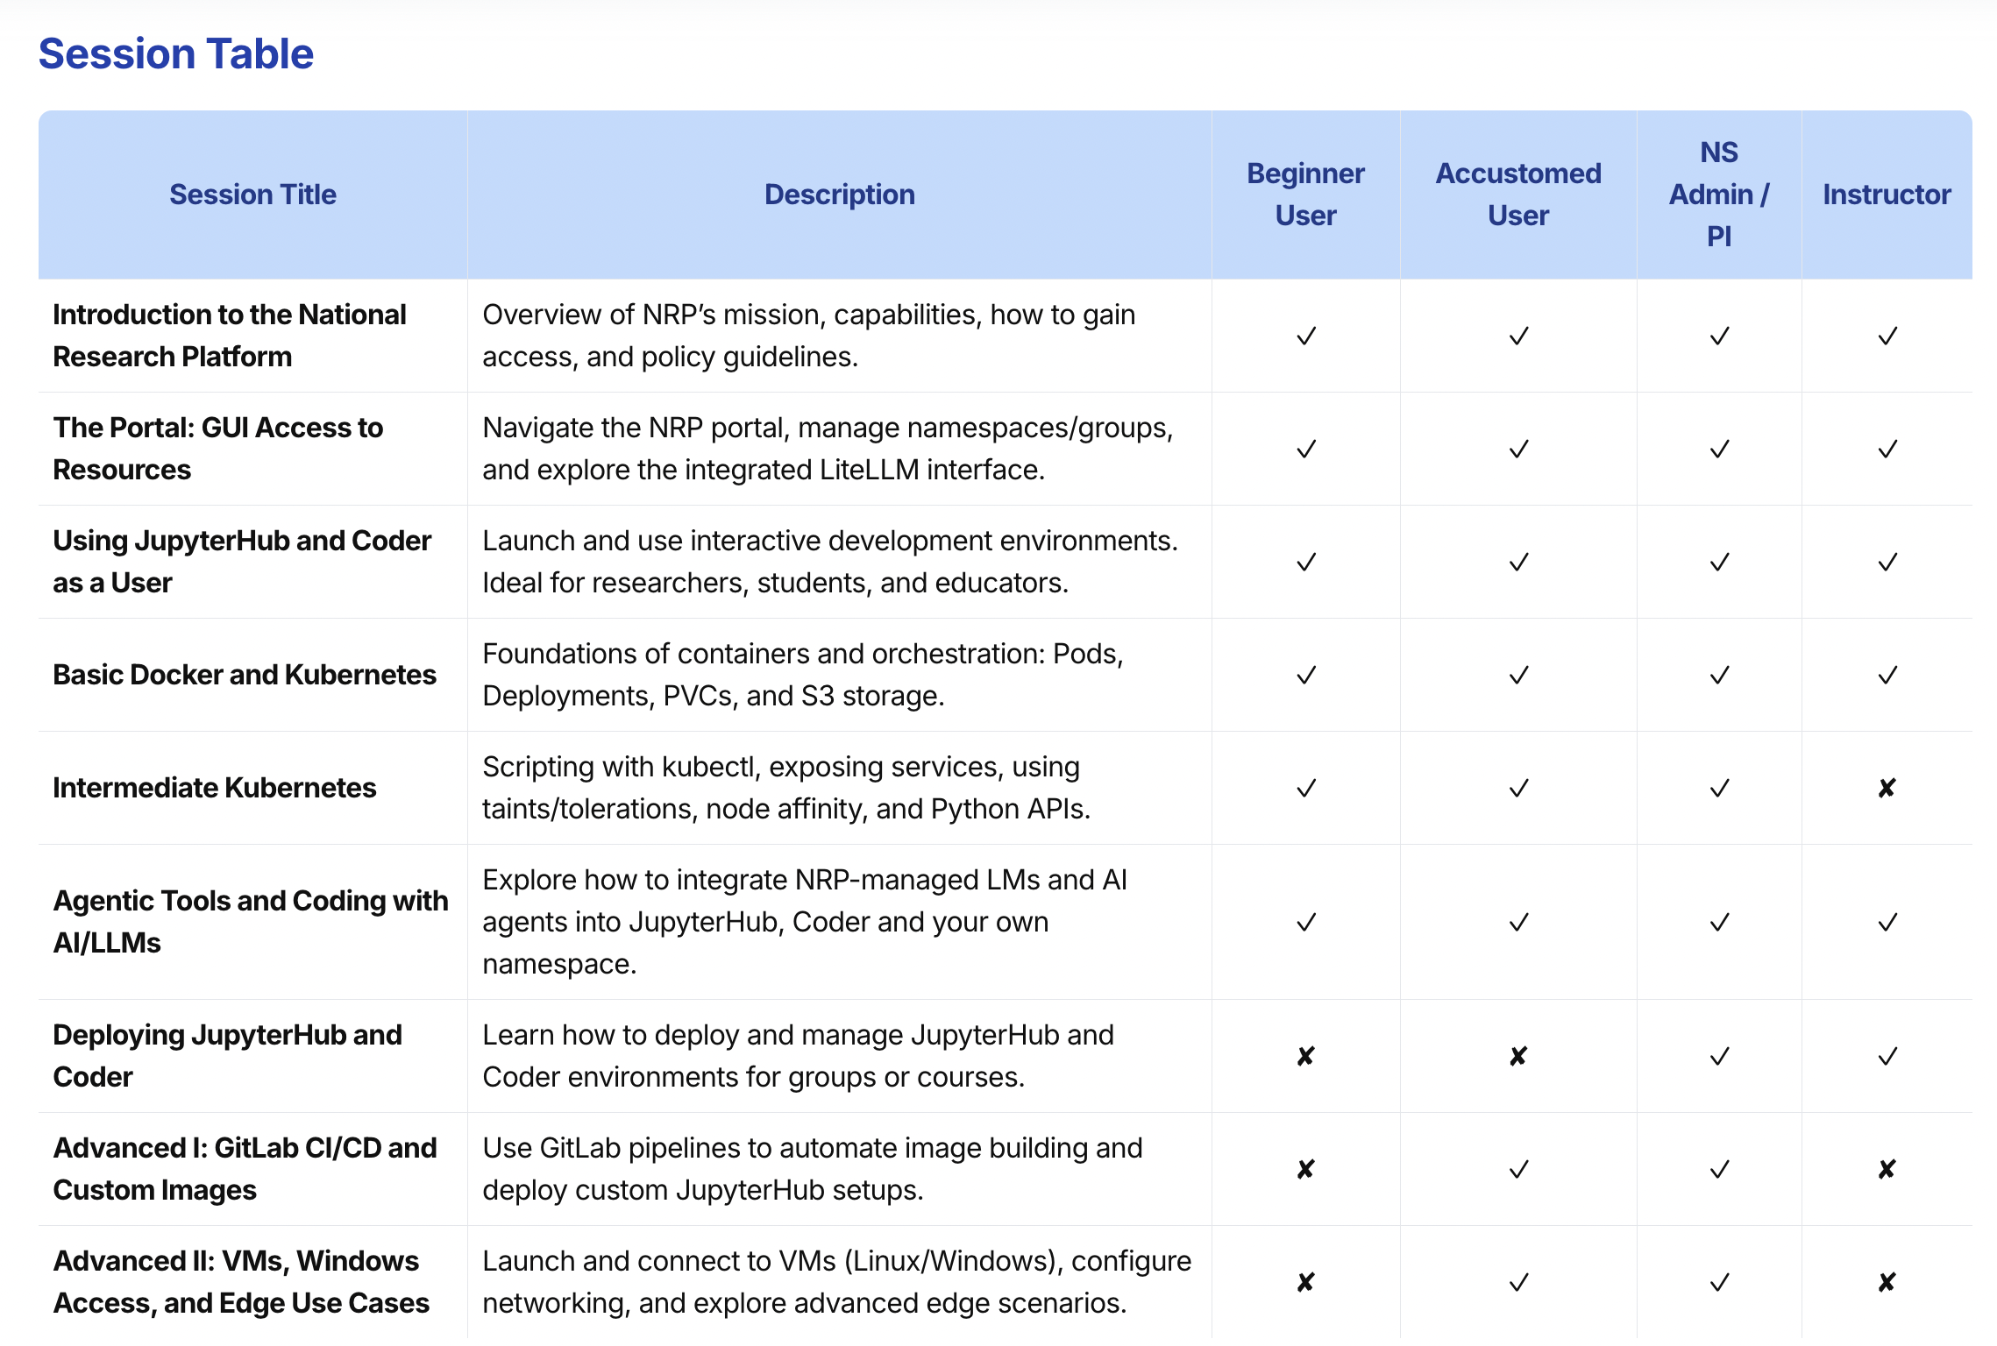

Slide 3
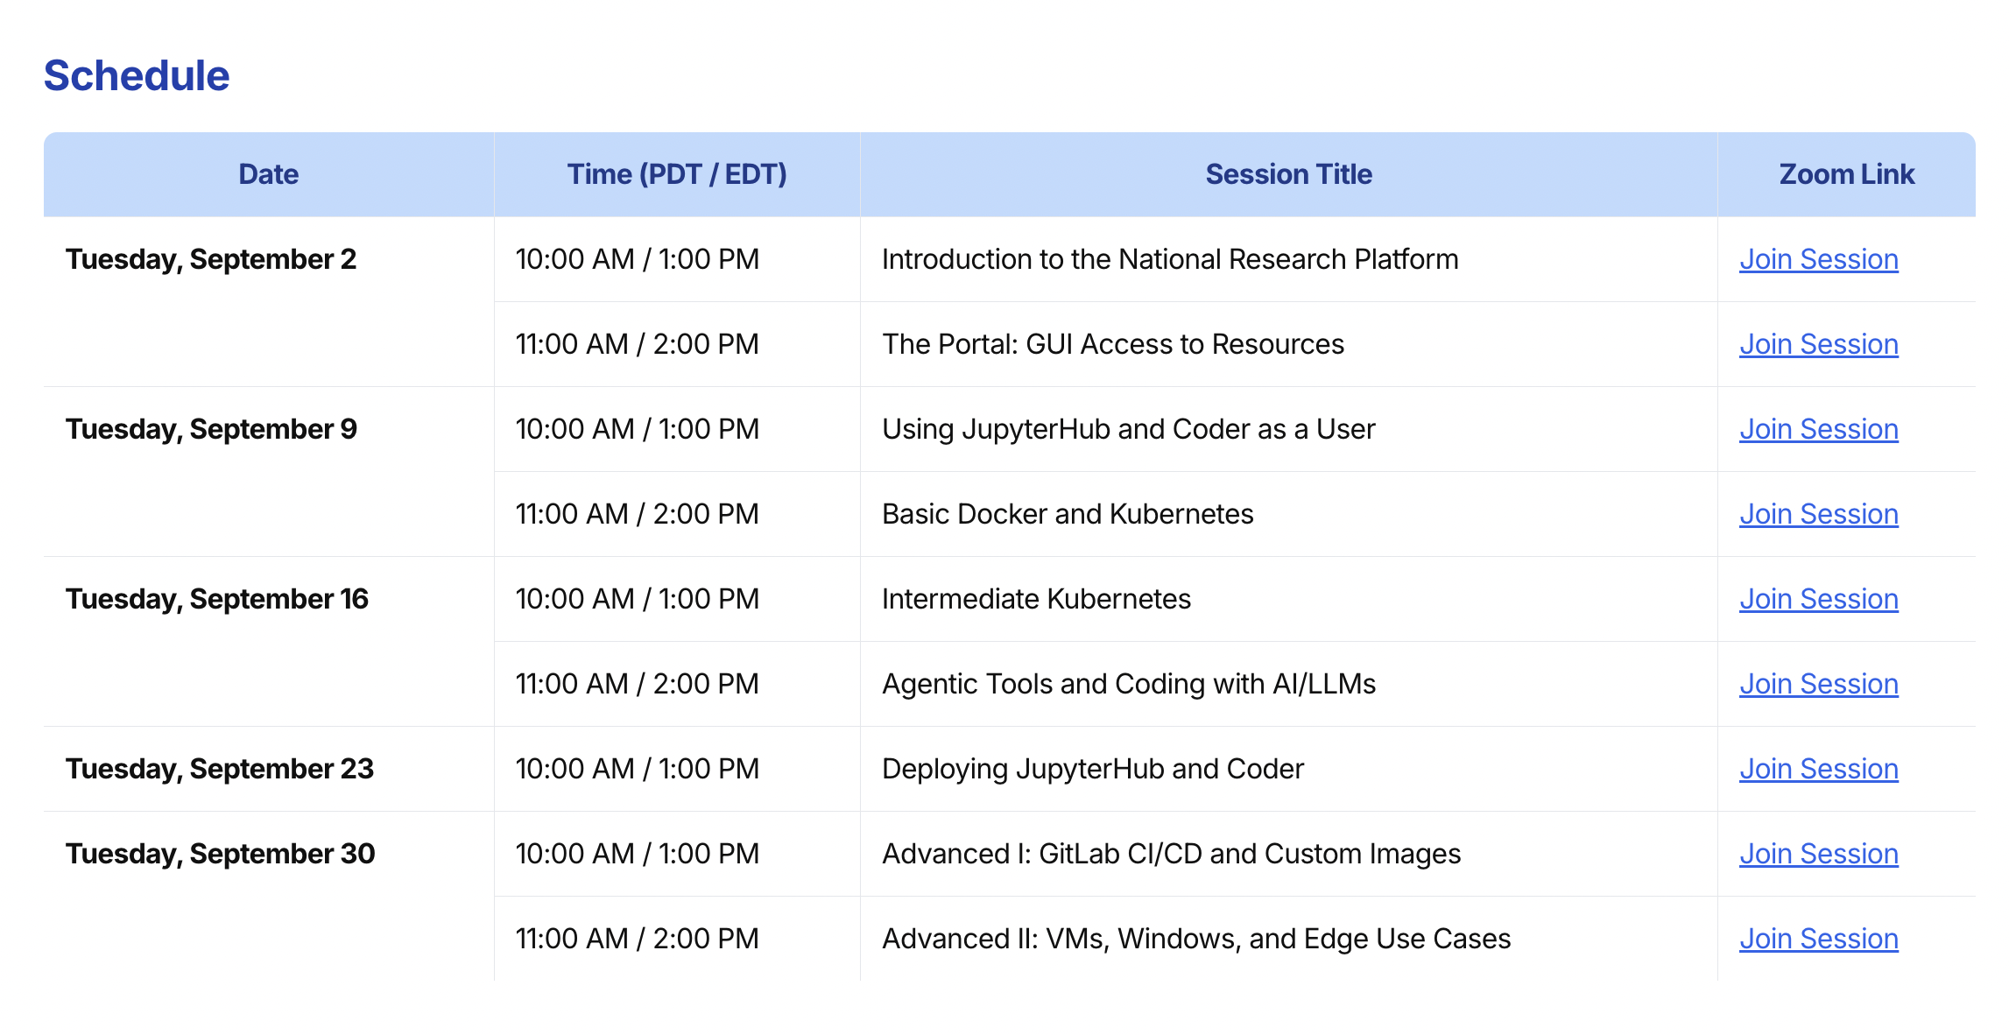
https://nrp.ai/training/

Slide 4
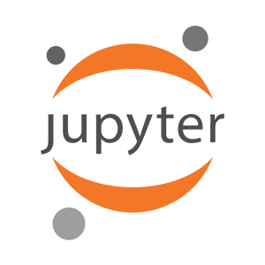

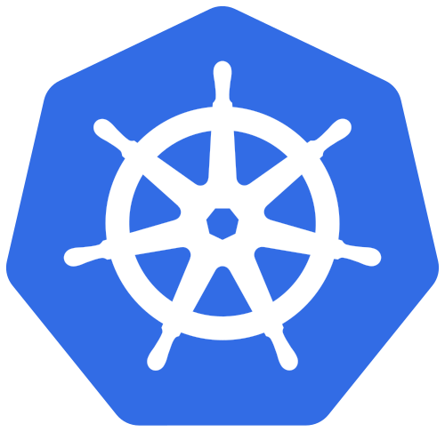
Using Nautilus and NRP
JupyterHub
Coder
Kubernetes
To access any of these services, you need to be part of a namespace/group on: https://nrp.ai/namespaces/

Slide 5
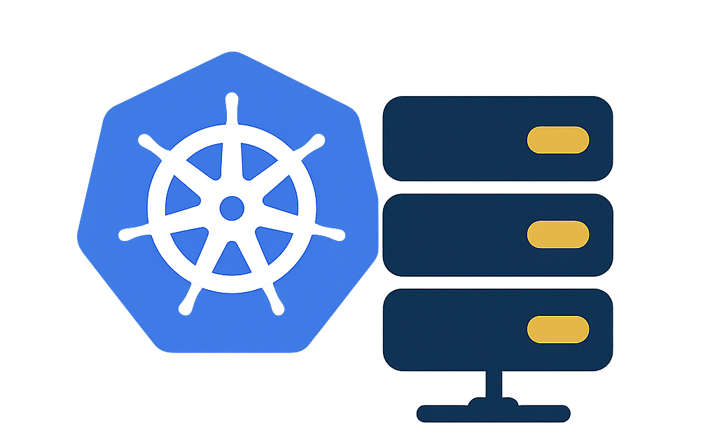
How to Join the Platform & Navigate the Portal
National Research Platform Fall Training Series

Slide 6
Session Agenda
NRP’s Website Resources
Logging In & Gaining Access
Hierarchical Resource Model
Namespace Management & Permissions
Platforms: JupyterHub, Coder & Kubernetes
Best Practices & Policies

Slide 7
NRP’s Website Resources
https://nrp.ai

Slide 8
Logging In & Getting Access
Navigate to the NRP Nautilus portal: https://nrp.ai/documentation/userdocs/start/getting-started/
Authenticate via your institution using CILogon; fallback options: Microsoft, Google, GitHub
Upon first login, an account is created automatically
We use Authentik for authentication for all services/apps.
For students: ask your supervisor to add you to their namespace (you become a user)
For faculty/researchers: request namespace admin status via Matrix, this grants ability to create namespaces and invite users

Slide 9
Hierarchical Resource Model
NRP uses a multi-layered structure: Organization → Lab → Project
Projects map directly to Kubernetes namespaces: secure, isolated units for workloads
Admins (labs or project leads) can manage membership, create projects/namespaces, and allocate resources
Resource allocation is fair and dynamic, with added prioritiziation for hardware contributions: https://nrp.ai/documentation/userdocs/start/hierarchy/

Slide 10
Namespace Management & Permissions
Namespaces = Projects
Every project corresponds to a Kubernetes namespace
Provides isolation for resources, users, and workloads https://nrp.ai/documentation/userdocs/start/hierarchy/
Roles in a Namespace
Admin: can create projects/namespaces, invite/remove users, and manage resources
User: can run jobs, use storage, and access cluster resources within their namespace
Membership Workflow
Faculty/Researchers request admin status via Matrix
Students join namespaces by being invited by their PI/supervisor https://nrp.ai/documentation/userdocs/start/getting-started/

Slide 11
Platforms: JupyterHub, Coder & Kubernetes
NRP Nautilus clusters span globally (US, Asia, Europe); over 75 sites available via the portal’s dashboard
Access Options:
JupyterHub – web-based notebooks, no Kubernetes expertise required, open to all CILogon institutions
Coder – IDE-like interface in the browser; account requires admin approval via Matrix
kubectl (Kubernetes CLI) – full control over deployments, pods, jobs; must be in a namespace and familiar with Kubernetes https://nrp.ai/documentation/userdocs/start/using-nautilus/

Slide 12
Best Practices & Policies
Keep docs.nrp.ai bookmarked!
Join Matrix!
Use CILogon with Campus SSO + Campus IDP.
Keep namespaces organized by project or lab.
Don’t use generic or vague names for groups (kubernetes-project, biology-lab).
Fill in descriptive fields for group information.
Use namespace-level storage (PVCs) for persistence, and clean up. Not archival storage.
Onboard/Offboard users.
Clean up unused jobs/deployments to avoid quota issues + Monitor your pods and workflows.
Don’t idle resources.
Backup, backup, backup.
If not sure, ask.

Slide 13
Cluster Access via kubectl
https://nrp.ai/documentation/userdocs/start/getting-started/#cluster-access-via-kubectl

